Slide 1

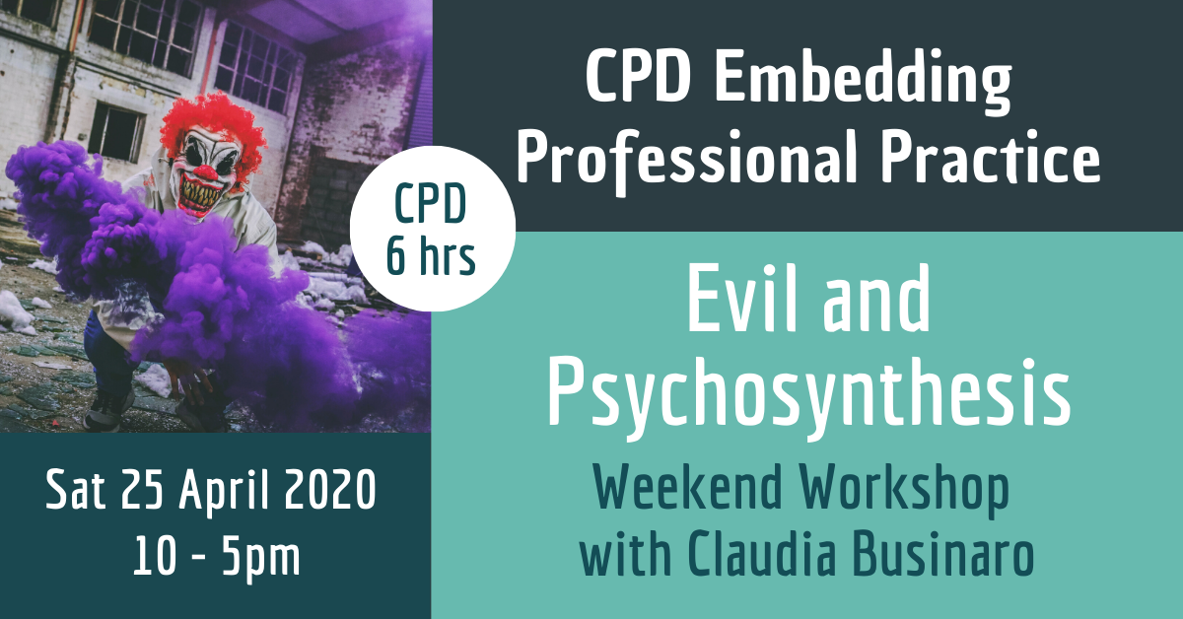
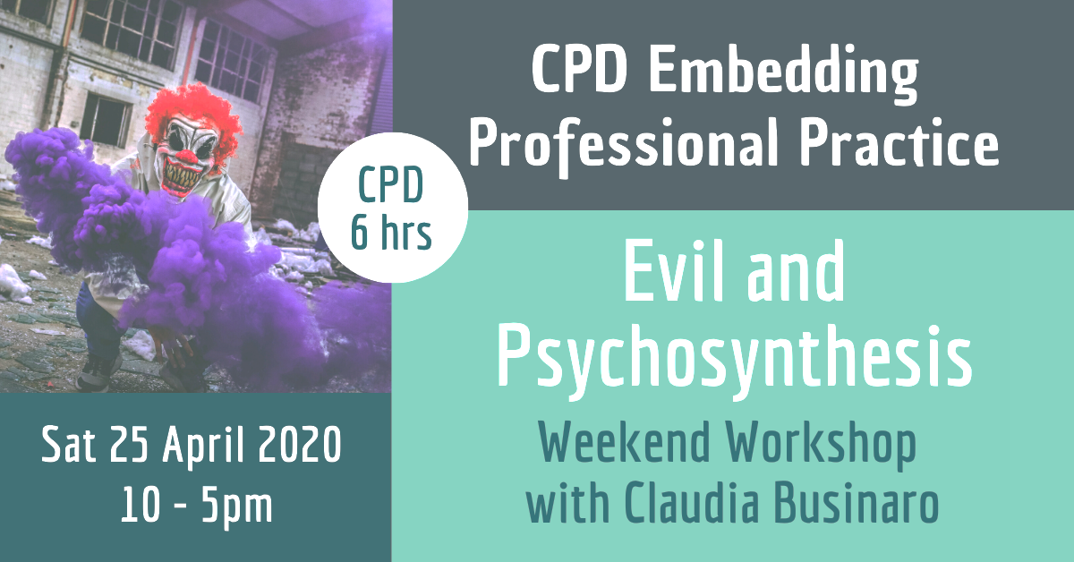

Psychological Disorders and their Assessment
June 2026 — Weekend Workshop
Notes:
- Welcome; 2-day workshop format; housekeeping.
V4.7 revised for tighter pacing, stronger learning-objective alignment, lighter morning exercises, and retained exercise instructions.
V4.8: one primary case-based exercise per session (Chen / Rahul / scenarios / Ellen–Kim); progressive difficulty; durations in speaker notes only.

Slide 2
Day 1 — Saturday Morning
10:00–13:00 | Foundations of assessment
Notes:
- Morning break 11:00 (20 min).
Primary exercise: Chen case (20–25 min) — see Chen slide notes.

Slide 3

Learning aims
Assess client suitability for psychosynthesis counselling.
undertake a competent initial assessment
recognising factors that would contra-indicate client suitability.
Understand the difference between on-line assessment and person to person assessment.
Understand the Power – Threat – Meaning Framework.
Notes:
- Walk through aims.
- Psychosynthesis-informed assessment, not diagnosis training.
V4.7 LO alignment: egg diagram; love/will; family systems; models integration; research-informed practice; mild/moderate vs severe disturbance; spiritual crisis framing.
V4.8: four case-based exercises (Chen → Rahul → scenarios → Ellen/Kim); difficulty increases each session.

Slide 4
Workshop schedule — 2 days
Day 1 Sat 10:00–17:00: foundations, suitability, defences, MSE
Breaks: 11:00 (20m) | Lunch 13:00–14:00 | 15:30 (20m)
Day 2 Sun 10:00–17:00: transference, risk, psychopathology, formulation
Four sessions; one case exercise per session (Chen 20–25 / Rahul 35–40 / scenarios 30–40 / formulation 60 min)
Notes:
- Confirm Sunday start time with group.
Revised V4.7 pacing: lighter mornings.
V4.8: progressive case exercises; full durations in speaker notes on each exercise slide.

Slide 5
Assessing the individual, ourselves and society
“How a particular society defines deviance, which may be couched in terms of mental illness, depends on how wide a range of behaviour that society allows to be acceptable… How a society explains deviance from the so-called norm will, in turn, depend on its own prevailing beliefs.” Alessandra Lemma (2009)
Reflective awareness involves how our own cultural, personal and theoretical constructs and assumptions can affect assessment. We need to consider how the intersectional aspects of our lived experience interface with the client’s intersectionality and affect our capacity to form a therapeutic alliance. Therefore, reflective awareness in counselling assessment means we need to apply self-assessment.
Notes:
- Social/contextual lens on distress.
- Lemma quote — reflexivity.

Slide 6
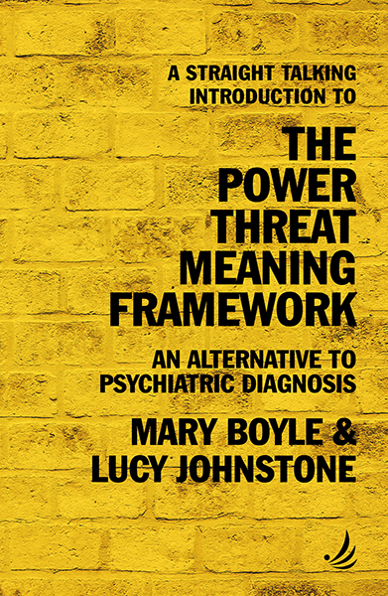
Many forms of troubling behaviour are understandable when viewed in the context of a person's life.
Also, the cultural and social norms we are expected to live up to and the degree to which we are exposed to trauma, abuse, injustice and inequality.
Notes:
- Behaviour understandable in life context.
- Link to PTM.

Slide 7
Power–Threat–Meaning Framework
Focus on power, threat, meaning — not diagnosis alone
What happened? How did it affect you? What sense? How did you survive?
Applications: hopeful narratives; social/contextual understanding
Implications: culturally sensitive, non-medical support
Notes:
- Merged V4.1 slides 11–12.

Slide 8
Psychological Mindedness
Client relates to their story
Increasing awareness
Ability to disidentify
Capacity to symbolise
Ability to tolerate anxiety, frustration, pain, stress
Increased responsibility
At least one “good enough” relationship
Capacity to build a therapeutic alliance
Relief when given feedback
Acceptance of the unconscious
Capacity to self-regulate
Notes:
- Define psychological mindedness.
- Bridge to disidentification — next slides.

Slide 9
Disidentification as an assessment lens
Can the client observe thoughts, feelings, impulses, roles?
Or fused with experience ('I am my anxiety')?
Listen for observation vs identification
Fragile disidentification → slower, stabilising work
Notes:
- Psychosynthesis insert.
- Example: 'I notice anger' vs 'I am furious'.

Slide 10
Observing self / "I"
Observing centre distinct from content of experience
Strong: reflect and choose | Fragile: flooded | Inaccessible: risk/referral
Link to neurosis/psychosis continuum later
Notes:
- Do not romanticise 'I'.

Slide 11
Psychosynthesis egg diagram as an assessment map
Use the egg diagram to hypothesise where distress is organised
Lower unconscious: trauma, fear, primitive defence, unmet need
Middle unconscious: current roles, adaptation, coping style
Higher unconscious: meaning, values, aspiration, emerging potential
Ask: what is wounded, defended, split off, and trying to emerge?
Notes:
Primal wounding, splitting, survival personality; developmental/purposive lens.

Slide 12
Psychosynthesis assessment questions
Which part feels this most strongly?
Which part copes or protects?
What can observe this?
What is trying to emerge?
What gives strength or meaning?
Notes:
- Prompts, not a checklist.

Slide 13
Subpersonalities in assessment
Listen for: inner critic, compliant self, rebel, wounded child
Survival personality may dominate early sessions
Which subpersonality is speaking now?
Notes:
- Link to defences this afternoon.

Slide 14
Psychosynthesis capacities for therapy
Grounding and affect tolerance
Reflective function and symbolisation
Disidentification and willingness/agency
Support networks; emerging meaning
Notes:
- Can this person use what we offer now?

Slide 15
Love and will in assessment
Disturbance may involve blocked love, damaged trust, or distorted will
Ask how the person relates, chooses, avoids, submits, controls, or collapses
Assess agency without blaming the client
Therapy may support the recovery of relatedness, choice, and inner direction
Notes:
Love/will and psychopathology — clinically grounded.

Slide 16
Intersectionality in assessment
Overlapping social categories shape experience and access
Reflect: how do your identities interface with the client's?
Discuss privileged vs oppressed axes — limits of models
Notes:
- Merged slides 23–26.

Slide 17
Family systems and hidden dynamics
Distress may be shaped by family roles, loyalty binds, secrets, and unspoken rules
The identified client may carry conflict that belongs to a wider system
Ask what is expressed individually and what may be systemic
Psychosynthesis assessment includes both person and relational field
Notes:
Group dynamics and systemic disturbance in first assessment.

Slide 18
Case study: Chen — PTM application
International student; academic and family pressure
Apply PTM questions in groups (Chen-PTM-answers.docx)
Intersectionality: culture, class, migration, age
Is Chen suitable now? What else to explore?
Notes:
Case study: Chen — PTM application (Day 1 Sat AM) Duration: 20–25 minutes Aim: Practise PTM questions and intersectionality thinking with an international student struggling with adjustment/academic performance. Handout: Chen-PTM-answers.docx (facilitator background — do not paste full text on slides). Groups apply PTM and intersectionality; discuss basic suitability and what else to explore; brief share-back.

Slide 19
Day 1 — Saturday Afternoon
14:00–17:00 | Modality, risk, defences, MSE
Notes:
- Exercise 2 — 25–30 minutes.
Primary exercise: Rahul case (35–40 min) — see Session Exercise notes.

Slide 20
Online vs in-person assessment
Differences: presence, non-verbal cues, environment, technology
Online: access vs staging, privacy, connectivity
In-person: fuller observation; travel and safety
Match modality to client and context
Notes:
- Merged slides 31–35 and 141–143.

Slide 21
Assessing for suicide and self-harm
Direct, compassionate risk questions when indicated
Know local pathways: GP, crisis teams, A&E, Papyrus
Document risk, safety plan, and escalation
Notes:
- Removed website screenshot slide.

Slide 22
Initial screening tools — role and limits
Brief measures support screening and outcome monitoring — not diagnosis
Common in IAPT/NHS: PHQ-9, GAD-7, CORE-10, CORE-OM
Integrate with interview, history, formulation, risk, functioning
Notes:
- Recovered from V4.2; repositioned Day 1 AM.

Slide 23
CORE-OM
34-item self-report; wellbeing, symptoms, functioning, risk
Used in NHS/IAPT for outcome monitoring
Strengths: holistic, tracks change | Limits: self-report, not diagnostic
Notes:
- Contrast with CORE-10.

Slide 24
CORE-10 — what it measures
10-item distress measure derived from CORE-OM
Score bands: healthy (0–5) through severe (25+)
Widely used before/after sessions in IAPT
Screening/monitoring only — not diagnosis
Notes:
- Show sample form if available.

Slide 25
PHQ-9 — depression screening
9 items; depressive symptoms over past 2 weeks
Common in primary care and IAPT stepped care
Severity bands guide conversation — not diagnosis alone
Item 9 (suicidality): always follow up with risk assessment
Notes:
- Recovered from V4.2 PDF.

Slide 26
GAD-7 — anxiety screening (brief)
7-item generalized anxiety screener
Often paired with PHQ-9 in NHS settings
Screening tool — interpret with clinical judgement
Notes:
- Brief NHS-context coverage.

Slide 27
Indicators of client suitability
Some insight and curiosity about inner life
Capacity for at least one 'good enough' relationship
Willingness to engage; realistic expectations
Support network where relevant
Psychological mindedness — not necessarily sophistication
How has client been referred for therapy?
Client has had the experience of at least one “good enough” relationship
Support network: availability of, and client’s willingness / ability to use it
Psychological mindedness vs. psychological sophistication
Notes:
- Indicators not gatekeeping.
- Referral and supervision cues.
Pair discussion (retained): suitability factors and exclusion criteria.

Slide 28
Higher concern / referral indicators
The client:
has been diagnosed with a personality disorder
has had previous therapy with no improvement or perceived benefit
presents with severe chemical addiction
has made suicide attempts recently
demonstrates severe acting out and self-destructive behaviour
has received recent and/or repeated ECT treatment
has been recently hospitalised for a psychiatric disorder
is on psychotropic or other medication (depending on medication)
presents with severe borderline (emotional instability disorder) or severe narcissistic traits
presents with psychosis
In or awaiting trial or court proceedings
Some severe eating disorders eg anorexia nervosa
Notes:
- Higher concern — not automatic exclusion.
- Trainees refer and supervise.

Slide 29
Defense mechanisms
QUESTIONS:
1. What are defense mechanisms and what are they for?
2. Do they happen consciously or unconsciously?
Notes:
- Opening questions on defences.
- Normalise before pathologising.
Brief definition: unconscious strategies to manage anxiety and threat.

Slide 30
Defence mechanisms 1–5 (summary)
Repression: The ego pushes unacceptable thoughts, feelings, or memories into the unconscious.
Regression: The ego reverts to a more infantile stage of development in response to stress.
Reaction formation: The ego adopts an extreme attitude that is the opposite of the true feeling.
Projection: The ego attributes its own unacceptable thoughts, feelings, or motives to someone else.
Rationalization: The ego provides a logical explanation for behavior that is actually motivated by unconscious factors.
Notes:
- Summarise mechanisms 1–5 with examples.

Slide 31
Defence mechanisms 6–10 (summary)
Isolation: The ego separates the emotional component from a traumatic event, allowing the person to think about the event without feeling any emotion.
Sublimation: The ego redirects unacceptable impulses into socially acceptable activities.
Undoing: The ego performs an action that is the opposite of an unacceptable impulse, in an attempt to cancel out the impulse.
Somatization: The ego converts anxiety into physical symptoms.
Notes:
- Summarise 6–10; note spiritual bypassing.

Slide 32
Mental status exam — nine domains
Appearance; behaviour / psychomotor activity
Attitude; mood and affect; speech and thought
Perceptual disturbances; orientation; memory/cognition
Reliability, judgement, and insight
Notes:
- Recovered from V4.2 PDF.

Slide 33
MSE in practice
Observe systematically; note present and absent
Integrate MSE with PTM and psychosynthesis listening
Pairs: list five MSE observations for a first meeting
Notes:
- Psychosynthesis: which part presents? observed vs fused?

Slide 34
Psychosynthesis assessment domains
Hold MSE alongside psychosynthesis listening:
Subpersonalities and survival patterns
Disidentification and observing self
Will, agency, meaning; resources and emergent potential
Notes:
- Topics doc insert after MSE.

Slide 35
Session Exercise
Title: Client suitability — case 'Rahul'
Aim: Suitability, risk, modality, psychosynthesis lens
Three groups with case handout; 2-minute rationale
Notes:
Title: Client suitability — case 'Rahul' (Day 1 Sat PM) Duration: 35–40 minutes Aim: Apply suitability criteria, risk assessment, and psychosynthesis lens to a complex referral (bipolar disorder, BPD traits, high-risk behaviours). Handout: Suitability-for-Counselling-Case-Exercise-Rahul.docx Three groups with case handout; assess suitability, risks, referral; modality (online vs in-person); 2-minute rationale: work now, wait, or refer.

Slide 36
Psychological Disorders and their Assessment
June 2026 — Sunday
Notes:
- Welcome Day 2; recap Day 1.
- Preview transference, risk, dissociation.

Slide 37
Day 2 — Sunday Morning
10:00–13:00 | Transference, risk, dissociation
Notes:
- Exercise 3 — 15–20 minutes.
Primary exercise: transference/countertransference/risk scenarios (30–40 min).

Slide 38
Opening reflection
Assessment requires humility
Coltart: anxiety and not-knowing in the assessor
Relationship as assessment instrument
Notes:
- Optional 3-minute pause.

Slide 39

Brief reflection (optional)
Notes:
- 10-minute partner brainstorm on own defences.
Full original instructions:
Question: What are your go-to defense mechanisms?
Original exercise: 10 min w partner
10-minute partner brainstorm on own defences.

Slide 40
transference
Client's perspective: It's the unconscious redirection of feelings and attitudes from significant figures in a client's past (like parents or caregivers) onto the therapist.
What it looks like: The client might feel intense positive emotions like idealisation or see the therapist as a source of strength, or they might experience negativity like anger or distrust based on past experiences.
Role of the therapist: The therapist helps the client understand and process these feelings in a healthy way, using them to gain insight into their past relationships and develop new patterns of interaction.
Notes:
- Define transference with examples.
- Idealisation, mistrust, parental feelings.

Slide 41
counter-transference
Therapist's perspective: It's the therapist's own unconscious feelings and experiences triggered by the client.
What it looks like: The therapist might feel empathy, warmth, or even frustration or irritation towards the client.
Importance of management: While some emotions like empathy can be helpful for building rapport, strong countertransference reactions need to be managed through self-awareness and supervision to avoid clouding judgment or impacting the therapeutic relationship negatively.
Notes:
- Countertransference; supervision and self-care.

Slide 42
Transferential field — brief
Transference: client feelings from past onto therapist
Countertransference: therapist responses to client
Field: unconscious interaction — use supervision
Notes:
- Simplify transferential field for year 1.

Slide 43
Dissociation in the transferential field
Therapist ungrounded; client cannot recall a topic
Shared avoidance — tread carefully; ground first
Notes:
- One dissociation example only.

Slide 44
Risk Assessment
Is the client well enough to benefit from counselling at this time or do they need a referral to mental health services?
Do you need to liaise with other health professionals?
How can risk be reduced?
BACP –Ethical framework consider requirements to do no harm, integrity, humility, candour
Drugs and Alcohol assessment
Suicidal indicators: ideation/recent attempts
Self harm
Recent episodes of serious acting out eg use of violence
Notes:
- Risk assessment — BACP ethics.
- Consult, refer, document.

Slide 45
What questions do I ask?
Useful questions…
What brings you here?
Why now?
Tell me about the relationships that support you
What is going on for you when you talk about this experience?
How is it to be here with me?
What was your experience of the counselling you have had in the past? What worked and what didn’t work so well?
Without going into a lot of detail today, can you tell me about any significant events in your past?
Risk assessment
Support network
Previous experience of counselling
Why now?
Biographical data – relationships with family of origin as a child and now , siblings, , school experience, relationships, work, disabilities and health issues, current living arrangements
Significant events and /or losses
What makes their heart sing or sink?
Notes:
- Model calm, direct risk enquiry.
- Walk through useful opening questions.

Slide 46
Self-harm vs suicidality
Self-harm: often emotion regulation; may not want to die
Suicidality: intent, plan, timeframe matter
Overlap possible — assess compassionately
Notes:
- Merged slides 73–74.

Slide 47
Dissociation — screening and specialist assessment
Consider when: trauma history, memory gaps, depersonalisation
DES-II: dissociative experience screening
SDQ-20: somatoform dissociation (specialist/research)
DDIS, SCID-D: specialist structured assessment
Screening ≠ diagnosis; trauma-informed phased assessment
Notes:
- Not universal frontline NHS tool for all counsellors.

Slide 48
Session Exercise
Title: Transference, countertransference, and risk
Aim: Read relational dynamics and risk in short scenarios
Groups: 3–5 scenarios; identify transferential and risk cues; debrief
Notes:
Title: Transference, countertransference, and risk (Day 2 Sun AM) Duration: 30–40 minutes Aim: Practise reading transference, countertransference, and risk in 3–5 short assessment scenarios. Five scenarios in groups; pairs identify transference, countertransference, risk; 5-minute debrief per scenario. Only case-based/clinical exercise in Sunday AM block.

Slide 49
Day 2 — Sunday Afternoon
14:00–17:00 | Psychopathology, formulation
Notes:
- Exercise 4 — 35–45 minutes.
Primary exercise: integrated formulation workshop (60 min capstone).

Slide 50
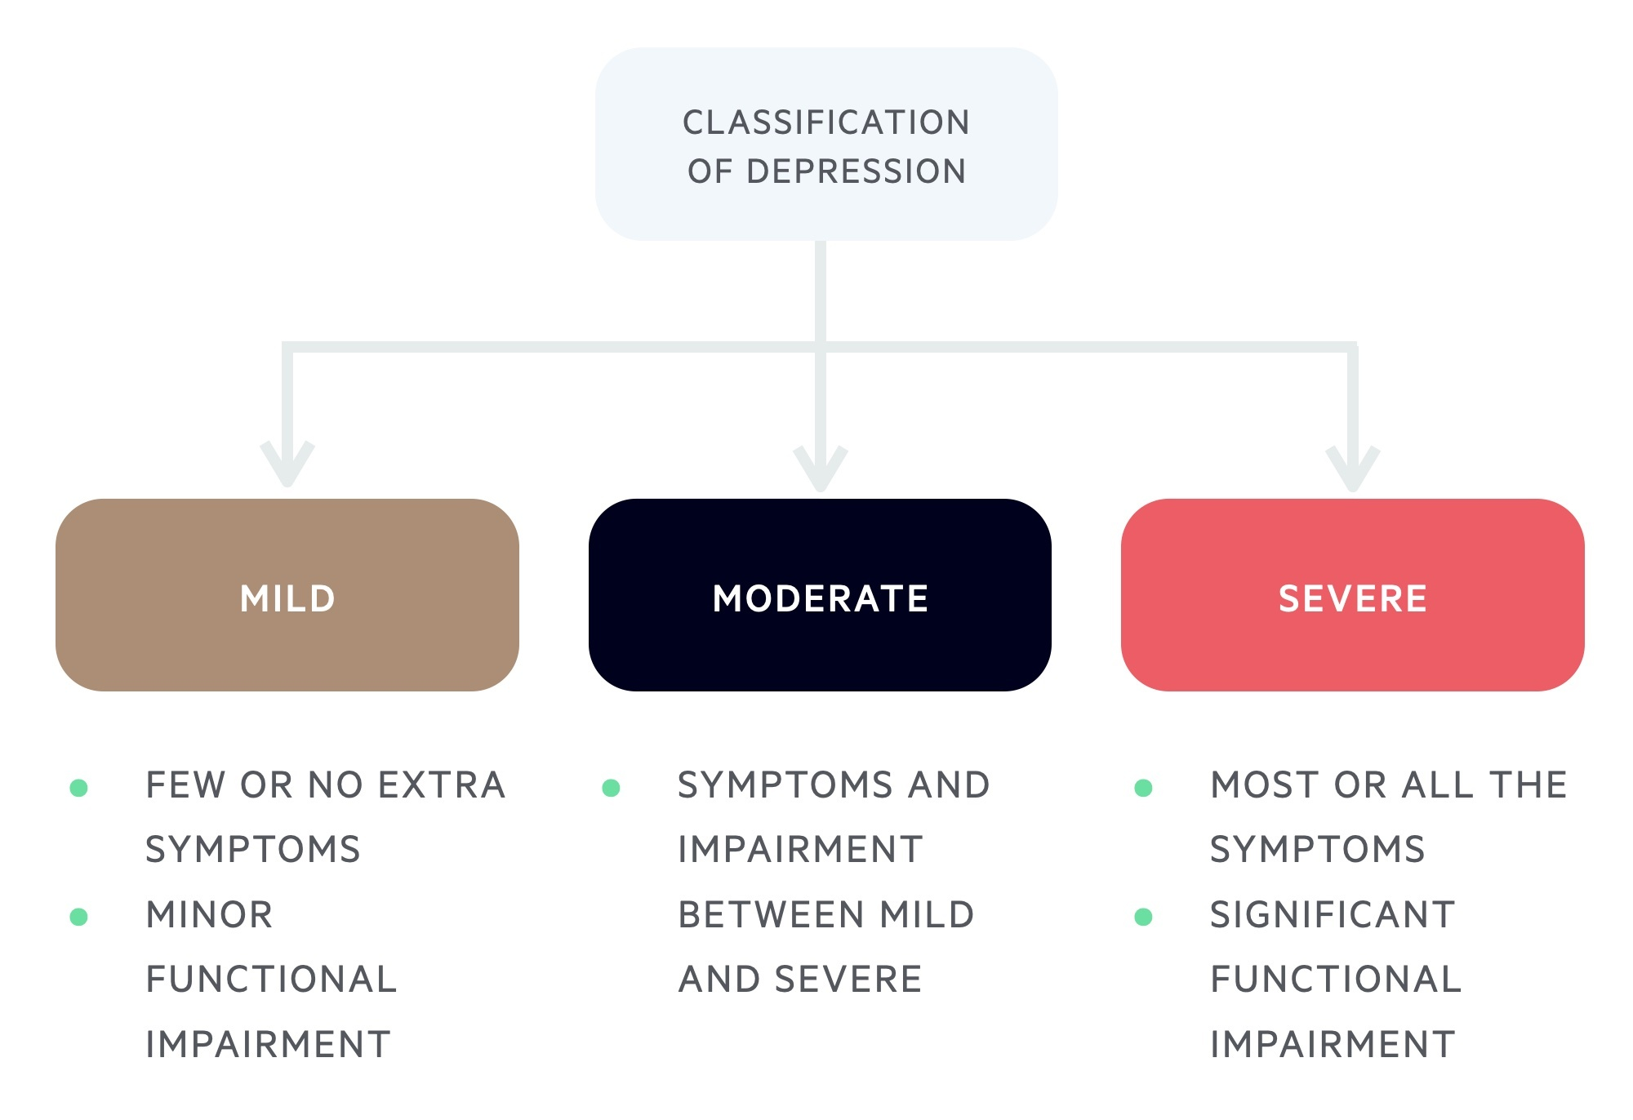
Understanding mild to moderate psychological disturbances
Notes:
- Mild–moderate continuum.
- Assess severity and fit for counselling.
Optional opening (retained): hopes and fears about neurosis, psychosis, spiritual emergencies, and mental illness.

Slide 51
Neurosis, psychosis, and spiritual emergency
Neurosis: conflict; generally intact reality testing
Psychosis: impaired reality testing; disorganisation
Spiritual emergency: assess for psychosis/risk — do not romanticise
When unsure: supervision, psychiatric opinion, safety first
Notes:
- Merged slide 84 + spiritual emergency insert.

Slide 52
Lower, middle, and higher unconscious in assessment
Lower: survival, trauma, defences
Middle: everyday personality and roles
Higher: meaning, values, aspiration
Listen across levels — not only pathology
Notes:
- Psychosynthesis insert.

Slide 53
Personality disorders — trainee overview
Enduring relational patterns — significant distress
Trainees recognise; specialists diagnose
Cluster B most seen in counselling settings
Describe behaviours — avoid labelling in session one
Notes:
- Condensed subtype lists and DBT staging slides.

Slide 54
Borderline patterns — recognition (not diagnosis)
Instability in relationships, affect; fear of abandonment
Self-harm, impulsivity, emptiness may appear
Assess risk; refer when beyond trainee scope
Notes:
- Ellen case in Exercise 4.

Slide 55
Narcissistic patterns — brief recognition
Grandiosity, admiration need, empathy difficulties at clinical threshold
Vulnerability may sit beneath defensive superiority
Maintain boundaries; supervise
Notes:
- Condensed slide 105.

Slide 56
Writing session notes
Comprehensive, objective, confidential, accurate, timely
Document risk and referral actions clearly
Follow agency/IAPT templates where applicable
Notes:
- Merged slides 108–110.

Slide 57
ICD-11 / DSM-5 — brief comparison
ICD: WHO/international | DSM: US/research influence
Use labels to communicate — not replace formulation
Stay critical and client-centred
Notes:
- Merged 112–113; DSM contents removed.
Discussion prompt (retained): pros and cons of mental health labels.

Slide 58
Eating disorders — assessment essentials
Clinical ED vs disordered eating — refer medical risk
Explore shame, control, trauma — not food alone
No weight comments or dietary advice
Notes:
- Condensed ED section.

Slide 59
From hypothesis to review
Initial assessment creates a working hypothesis, not a fixed truth
Review the formulation as new material, ruptures, and risks emerge
Adjust pace, strategy, and referral thinking over time
Notes:
Bridges assessment to ongoing formulation.

Slide 60
Hypothesising and formulation
Three lenses: intrapersonal, interpersonal, emergent potential
Hold working hypothesis lightly; revise with data
Notes:
- From slides 59/68 themes.

Slide 61
Psychosynthesis formulation map
History, context, power, trauma, culture
Wound, defences, subpersonalities / survival personality
Relational pattern; early transference signs
Will, resources, emerging direction; risk and plan
Notes:
- Use in Exercise 4.

Slide 62
What makes an assessment psychosynthesis-informed?
Pathology and potential held together
Disidentification, subpersonalities, will, meaning included
Standardised tools within wider formulation
Ethical scope, supervision, referral integrated
Notes:
- Summary before final exercise.

Slide 63
Cognitive tools and negative automatic thoughts
NATs reveal beliefs and defences in assessment
CBT tools complement — do not replace — psychosynthesis
Ask: which part holds this thought?
Notes:
- Merged slides 142–145.

Slide 64
Psychosynthesis and other models
DSM / ICD can support communication and referral, but do not replace formulation
CBT can clarify thoughts, beliefs, and maintaining cycles
PTM reframes distress through context, survival, and meaning
Psychosynthesis adds subpersonalities, will, meaning, and emergent potential
Notes:
How psychosynthesis differs from and integrates other models.

Slide 65
Session Exercise
Title: Integrated case formulation workshop
Aim: Psychosynthesis-informed formulation and assessment plan
Groups: Ellen (BPD) or Kim (ED); formulation map + screening tools
5-minute group presentation
Notes:
Title: Integrated case formulation workshop (Day 2 Sun PM — capstone) Duration: 60 minutes (must not exceed 70) Aim: Produce a psychosynthesis-informed formulation and assessment plan (Ellen BPD or Kim ED). Handout: Ellen-BPD-initial-assessment.docx for Ellen (Kim = parallel ED option). Use formulation map; integrate psychopathology, risk, screening (CORE-OM/CORE-10, PHQ-9, GAD-7, dissociation measures as appropriate); 5-minute group presentation.

Slide 66
Day 1 recap — key threads
PTM; suitability; intersectionality; screening tools
Online/in-person; suicide risk; defences; MSE
Psychosynthesis listening throughout
Notes:
- Bridge to reading list.
V4.7 revised for tighter pacing, stronger learning-objective alignment, lighter morning exercises, and retained exercise instructions.
V4.8: one primary case-based exercise per session (Chen / Rahul / scenarios / Ellen–Kim); progressive difficulty; durations in speaker notes only.

Slide 67
Research-informed assessment practice
Use evidence, clinical judgement, and client context together
Screening tools support practice but do not diagnose by themselves
Different methods answer different questions: quantitative, qualitative, case-based
Stay critical, ethical, and up to date
Notes:
Brief intro to research-informed assessment for counselling trainees.

Slide 68
Reading List
Gelso, C.J. & Hayes, J. (2007) Countertransference & the Therapist's Inner Experience: Perils and Possibilities. New Jersey: Lawrence Erlbaum Associates, Inc.
Kriesman, J & Strauss (1991) I Hate You – Don’t Leave Me: Understanding the Borderline Personality. Avon.
Lemma, A. (1986) Introduction to Psychopathology. Sage.
Majors, R., Carberry, K. & Ranshaw, T. (eds) (2020) The International Handbook of Black Community Mental Health. Emerald Publishing Ltd.
Masterson, J.F. (1988) The Search for the Real Self. Unmasking Personality Disorders. Free Press.
Mollon, P. (2020) Pathologies of the Self: Exploring Narcissistic and Borderline States of Mind. Confer Books.
Moore, T. (1994) Care of the Soul. New York: HarperPerennial.
Nelson, J.E. (1991) Healing the Split: Madness or Transcendence? Tarcher.
van Rijn, B. (2015) Assessment and Case Formulation in Counselling and Psychotherapy. Sage.
Symington, N. (1993) Narcissism: A New Theory. Karnac Books.
American Psychiatric Association (2013) DSM-5: Diagnostical and Statistical Manual of Mental Disorders, 5th edition. APA.
Bentall, R.P. (2003) Madness Explained. Psychosis & Human Nature. Penguin Press.
Bollas, C. (1987) The Shadow of the Object: Psychoanalysis of the Unthought Known. Columbia University Press.
Burton, N. (2015) The Meaning of Madness. Acheron.
Casement, P.J. (1991) On Learning from the Patient. New York: Penguin Press.
Coltart, N. (1993) How to Survive as a Psychotherapist. Sheldon Press.
Davison, G. & Neale, J. (1995) Abnormal Psychology. NY Wiley & Sons.
Gomez, L. (1997) An Introduction to Object Relations. Free Association Books.
Grof, C. & Grof, S. (1990) The Stormy Search for the Self: understanding and living with spiritual emergency. Tarcher.
Littlewood, R & Lipsedge, M. (1997) Aliens & Alienists. Ethnic Minorities & Psychiatry. Routledge.
Ogden, Thomas H. (2005) Projective Identification & Psychotherapeutic Technique. New Jersey: Karnac
Wolpert, L. (1999) Malignant Sadness. The Anatomy of Depression. Faber.
Notes:
- Priority readings.
- Thank participants; evaluation if used.
V4.7 revised for tighter pacing, stronger learning-objective alignment, lighter morning exercises, and retained exercise instructions.

Slide 69
Exercise Instructions (Retained from Earlier Drafts)
Full original instructions for all session exercises
See speaker notes for complete facilitator detail
Notes:
Case study: Chen — PTM application (Day 1 Sat AM) Duration: 20–25 minutes Aim: Practise PTM questions and intersectionality thinking with an international student struggling with adjustment/academic performance. Handout: Chen-PTM-answers.docx (facilitator background — do not paste full text on slides). Groups apply PTM and intersectionality; discuss basic suitability and what else to explore; brief share-back. Title: Client suitability — case 'Rahul' (Day 1 Sat PM) Duration: 35–40 minutes Aim: Apply suitability criteria, risk assessment, and psychosynthesis lens to a complex referral (bipolar disorder, BPD traits, high-risk behaviours). Handout: Suitability-for-Counselling-Case-Exercise-Rahul.docx Three groups with case handout; assess suitability, risks, referral; modality (online vs in-person); 2-minute rationale: work now, wait, or refer. Title: Transference, countertransference, and risk (Day 2 Sun AM) Duration: 30–40 minutes Aim: Practise reading transference, countertransference, and risk in 3–5 short assessment scenarios. Five scenarios in groups; pairs identify transference, countertransference, risk; 5-minute debrief per scenario. Only case-based/clinical exercise in Sunday AM block. Title: Integrated case formulation workshop (Day 2 Sun PM — capstone) Duration: 60 minutes (must not exceed 70) Aim: Produce a psychosynthesis-informed formulation and assessment plan (Ellen BPD or Kim ED). Handout: Ellen-BPD-initial-assessment.docx for Ellen (Kim = parallel ED option). Use formulation map; integrate psychopathology, risk, screening (CORE-OM/CORE-10, PHQ-9, GAD-7, dissociation measures as appropriate); 5-minute group presentation.

